Slide 1
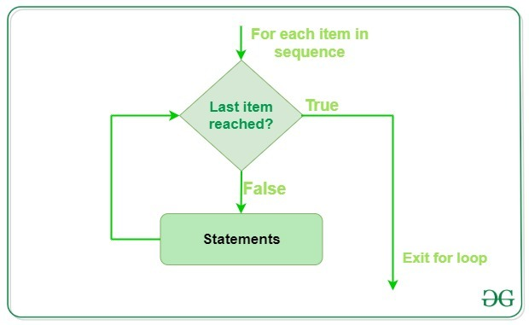
For loop in python

Slide 2
A for loop is used for iterating over a sequence
Syntax of for Loop
for val in sequence:
Body of for
Here, val is the variable that takes the value of the item inside the sequence on each iteration.
Loop continues until we reach the last item in the sequence.
The body of for loop is separated from the rest of the code using
indentation.
fruits = ["apple", "banana", "cherry"]
for x in fruits:
print(x)
Output:
apple
banana
cherry

Slide 3
Looping Through a String
Even strings are iterable objects, they contain a sequence of characters:
Example
Loop through the letters in the word "banana":
for x in "banana":
print(x)
Output:
b
a
n
a
n
a

Slide 4
The break Statement
With the break statement we can stop the loop before it has looped through all the items:
Example:
Exit the loop when x is "banana":
fruits = ["apple", "banana", "cherry"] fruits = ["apple", "banana", "cherry"]
for x in fruits: for x in fruits:
print(x) if x == "banana":
if x == "banana": break
break print(x)
Output: Output:
apple apple
banana

Slide 5
The continue Statement
With the continue statement we can stop the current iteration of the loop, and continue with the next:
Example
Do not print banana:
fruits = ["apple", "banana", "cherry"]
for x in fruits:
if x == "banana":
continue
print(x)
output:
apple
cherry

Slide 6
Else in For Loop
The else keyword in a for loop specifies a block of code to be executed when the loop is finished:
Example
Print all numbers from 0 to 5, and print a message when the loop has ended:
for x in range(6):
print(x)
else:
print("Finally finished!")
output:
0
1
2
3
4
5
Finally finished!

Slide 7

Nested Loops
A nested loop is a loop inside a loop.
The "inner loop" will be executed one time for each iteration of the "outer loop":
Example
Print each adjective for every fruit:
colour = ["red", "big", "tasty"]
fruits = ["apple", "banana", "cherry"]
for x in colour:
for y in fruits:
print(x, y)
red banana
red cherry
big apple
big banana
big cherry
tasty apple
tasty banana
tasty cherrypple
Output:

Slide 8
The pass Statement
for loops cannot be empty, but if you for some reason have a for loop with no content, put in the pass statement to avoid getting an error.
Example
for x in [0, 1, 2]:
pass

